Slide 1












Slide 2

















Model Predictive Controller
Geo-spatial data
Pre-processing
Optimizer
System model
Cost function
KML file
Constraints

Slide 4
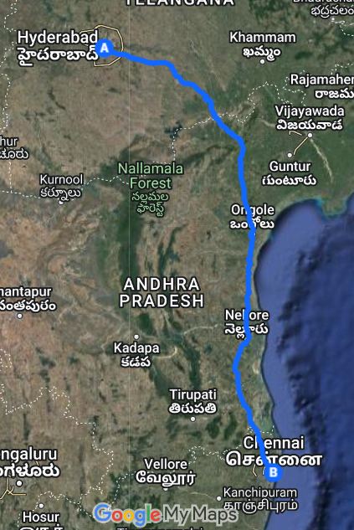
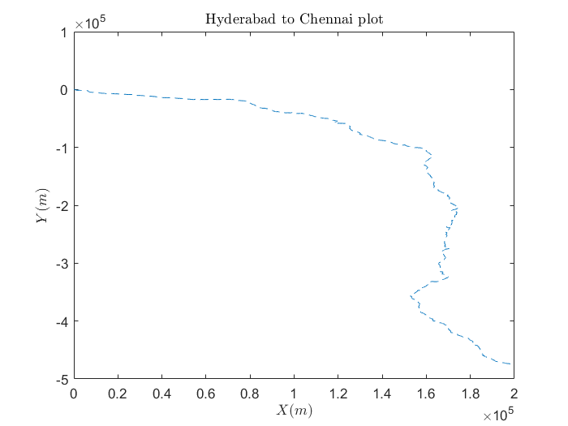

Slide 5
